Slide 1
General License Course
Chapter 7.5
Feed Lines

Slide 2
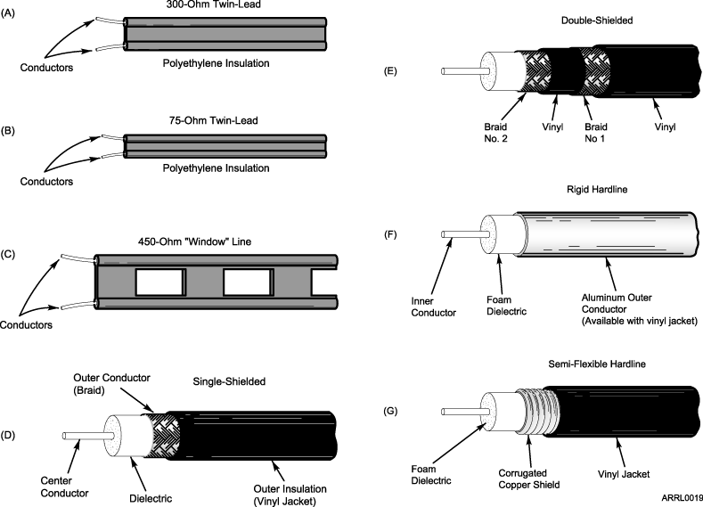
Feed Lines

Slide 3
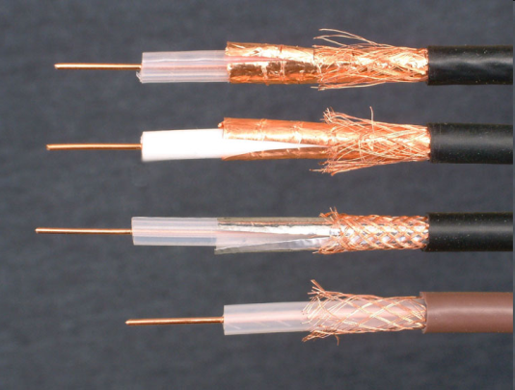
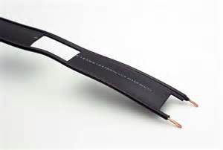
Feed Lines
The characteristic impedance (Z₀) of parallel conductor feed line is determined by the radius of the feed line conductors and the distance between their centers (also the material between them)
Open wire feed line generally has an impedance of 300 to 600 Ω “Window line” impedance is generally 450 ohms.
The most common impedances of coax that amateurs use are 50 Ω and 75 Ω

Slide 4
Feed Lines
Forward power – power traveling toward an antenna (load)
Reflected power – power reflected (rejected) because of an impedance mismatch at the antenna
Standing waves – interference wave pattern in a feed line from forward and reverse power
Standing wave ratio (SWR) equals the ratio of the antenna's impedance to the impedance of the feed line (with the lower Z = 1: always ?:1)
Short or open circuit at the feedpoint: SWR = infinite and all power reflected

Slide 5
Calculating SWR
What is the SWR in a 50 Ω feed line connected to a 200 Ω load?
SWR = 200/50 = 4:1
What is the SWR in a 50 Ω feed line connected to a 10 Ω load?
SWR = 50/10 = 5:1 (NOT 1:5)
What standing wave ratio will result from the connection of a 50 Ω feed line to a non-reactive load having a 50 Ω impedance
SWR = 50/50 = 1:1

Slide 6
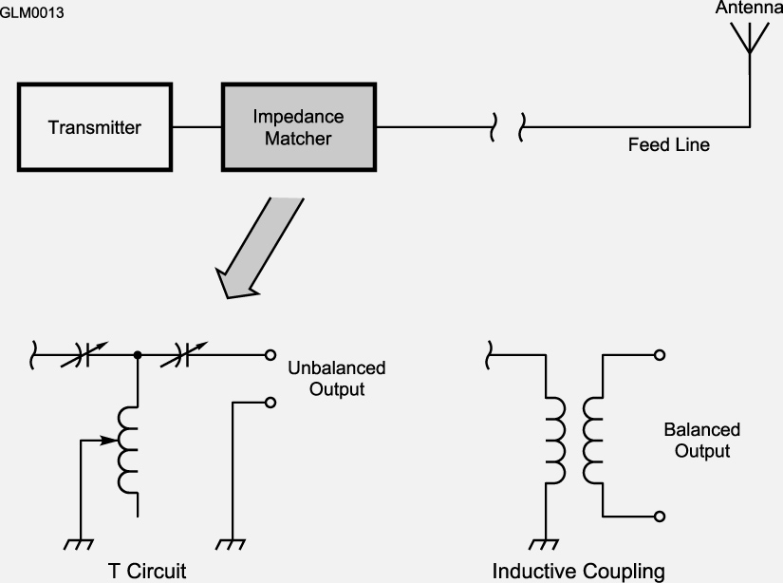
Antenna Tuner/Coupler
Reflected power is caused by an impedance mismatch between the feed line and the antenna feedpoint
An “antenna tuner” can be used at the transmitter end to match antenna system impedance to that of the transmitter to maximize power transfer
Any mismatch at the antenna feedpoint is still present as high SWR on the feedline; this only reduces strain on the transmitter
To minimize loss and prevent standing waves on the feedline use low-loss feedline and minimize SWR at the antenna feedpoint

Slide 7
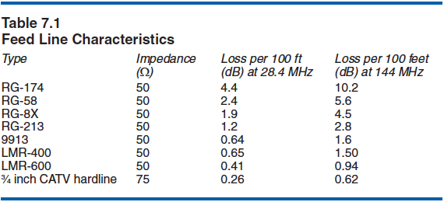
Feed Line Loss
Loss is measured in dB /100 ft of cable (assumes 1:1 SWR!)
Loss increases with frequency (heat, dielectric absorption)
(RG-8 equiv)
Generally, smaller coax has higher loss at a given frequency

Slide 8
SWR vs. Feed line Loss
When the SWR on a feedline is greater than 1:1, it will increase attenuation (loss) of the signal. If a transmission line is lossy, high SWR will increase the loss. To transfer the greatest amount of power to the antenna the SWR on the feedline should be 1:1
Transmission line loss will also have an effect on the SWR measured at the input to the line. The higher the transmission line loss, the more the SWR will read artificially low.

Slide 9
Take Quiz 1

Slide 10
G4A06 - What is the purpose of an antenna tuner?
A. Reduce the SWR in the feed line to the antenna
B. Reduce the power dissipation in the feedline to the antenna
C. Increase power transfer from the transmitter to the feed line
D. All these choices are correct

Slide 11
G4A06 - What is the purpose of an antenna tuner?
A. Reduce the SWR in the feed line to the antenna
B. Reduce the power dissipation in the feedline to the antenna
C. Increase power transfer from the transmitter to the feed line
D. All these choices are correct

Slide 12
G9A01 - Which of the following factors determine the characteristic impedance of a parallel conductor feed line?
A. The distance between the centers of the conductors and the radius of the conductors
B. The distance between the centers of the conductors and the length of the line
C. The radius of the conductors and the frequency of the signal
D. The frequency of the signal and the length of the line

Slide 13
G9A01 - Which of the following factors determine the characteristic impedance of a parallel conductor feed line?
A. The distance between the centers of the conductors and the radius of the conductors
B. The distance between the centers of the conductors and the length of the line
C. The radius of the conductors and the frequency of the signal
D. The frequency of the signal and the length of the line

Slide 14
G9A02 - What is the relationship between high standing wave ratio (SWR) and transmission line loss?
A. There is no relationship between transmission line loss and SWR
B. High SWR increases loss in a lossy transmission line
C. High SWR makes it difficult to measure transmission line loss
D. High SWR reduces the relative effect of transmission line loss

Slide 15
G9A02 - What is the relationship between high standing wave ratio (SWR) and transmission line loss?
A. There is no relationship between transmission line loss and SWR
B. High SWR increases loss in a lossy transmission line
C. High SWR makes it difficult to measure transmission line loss
D. High SWR reduces the relative effect of transmission line loss

Slide 16
G9A03 - What is the nominal characteristic impedance of "window line" transmission line?
A. 50 ohms
B. 75 ohms
C. 100 ohms
D. 450 ohms

Slide 17
G9A03 - What is the nominal characteristic impedance of "window line" transmission line?
A. 50 ohms
B. 75 ohms
C. 100 ohms
D. 450 ohms

Slide 18
G9A04 - What causes reflected power at an antenna's feed point?
A. Operating an antenna at its resonant frequency
B. Using more transmitter power than the antenna can handle
C. A difference between feed line impedance and antenna feed point impedance
D. Feeding the antenna with unbalanced feed line

Slide 19
G9A04 - What causes reflected power at an antenna's feed point?
A. Operating an antenna at its resonant frequency
B. Using more transmitter power than the antenna can handle
C. A difference between feed line impedance and antenna feed point impedance
D. Feeding the antenna with unbalanced feed line

Slide 20
G9A05 - How does the attenuation of coaxial cable change with increasing frequency?
A. Attenuation is independent of frequency
B. Attenuation increases
C. Attenuation decreases
D. Attenuation follows Marconi's Law of Attenuation

Slide 21
G9A05 - How does the attenuation of coaxial cable change with increasing frequency?
A. Attenuation is independent of frequency
B. Attenuation increases
C. Attenuation decreases
D. Attenuation follows Marconi's Law of Attenuation

Slide 22
G9A06 - In what units is RF feed line loss usually expressed?
A. Ohms per 1,000 feet
B. Decibels per 1,000 feet
C. Ohms per 100 feet
D. Decibels per 100 feet

Slide 23
G9A06 - In what units is RF feed line loss usually expressed?
A. Ohms per 1,000 feet
B. Decibels per 1,000 feet
C. Ohms per 100 feet
D. Decibels per 100 feet

Slide 24
G9A07 - What must be done to prevent standing waves on a feed line connected to an antenna?
A. The antenna feed point must be at DC ground potential
B. The feed line must be an odd number of electrical quarter wavelengths long
C. The feed line must be an even number of physical half wavelengths long
D. The antenna feed point impedance must be matched to the characteristic impedance of the feed line

Slide 25
G9A07 - What must be done to prevent standing waves on a feed line connected to an antenna?
A. The antenna feed point must be at DC ground potential
B. The feed line must be an odd number of electrical quarter wavelengths long
C. The feed line must be an even number of physical half wavelengths long
D. The antenna feed point impedance must be matched to the characteristic impedance of the feed line

Slide 26
G9A08 - If the SWR on an antenna feed line is 5:1, and a matching network at the transmitter end of the feed line is adjusted to present a 1:1 SWR to the transmitter, what is the resulting SWR on the feed line?
A. 1:1
B. 5:1
C. Between 1:1 and 5:1 depending on the characteristic impedance of the line
D. Between 1:1 and 5:1 depending on the reflected power at the transmitter

Slide 27
G9A08 - If the SWR on an antenna feed line is 5:1, and a matching network at the transmitter end of the feed line is adjusted to present a 1:1 SWR to the transmitter, what is the resulting SWR on the feed line?
A. 1:1
B. 5:1
C. Between 1:1 and 5:1 depending on the characteristic impedance of the line
D. Between 1:1 and 5:1 depending on the reflected power at the transmitter

Slide 28
G9A09 - What standing wave ratio results from connecting a 50-ohm feed line to a 200-ohm resistive load?
A. 4:1
B. 1:4
C. 2:1
D. 1:2

Slide 29
G9A09 - What standing wave ratio results from connecting a 50-ohm feed line to a 200-ohm resistive load?
A. 4:1
B. 1:4
C. 2:1
D. 1:2

Slide 30
G9A10 - What standing wave ratio results from connecting a 50-ohm feed line to a 10-ohm resistive load?
A. 2:1
B. 1:2
C. 1:5
D. 5:1

Slide 31
G9A10 - What standing wave ratio results from connecting a 50-ohm feed line to a 10-ohm resistive load?
A. 2:1
B. 1:2
C. 1:5
D. 5:1

Slide 32
G9A11 - What is the effect of transmission line loss on SWR measured at the input to the line?
A. Higher loss reduces SWR measured at the input to the line
B. Higher loss increases SWR measured at the input to the line
C. Higher loss increases the accuracy of SWR measured at the input to the line
D. Transmission line loss does not affect the SWR measurement

Slide 33
G9A11 - What is the effect of transmission line loss on SWR measured at the input to the line?
A. Higher loss reduces SWR measured at the input to the line
B. Higher loss increases SWR measured at the input to the line
C. Higher loss increases the accuracy of SWR measured at the input to the line
D. Transmission line loss does not affect the SWR measurement

Slide 34
General License Course
Chapter 9.1
Electrical Safety

Slide 35
Electrical Safety
Don’t work on “live” equipment unless absolutely necessary
Avoid working alone on energized high voltage equipment - especially vacuum tube transmitters/amplifiers
Never assume equipment is off or de-energized — check with a meter or tester first
Working on feed lines or antennas – be sure that a transmitter or amplifier can’t be activated
Keep one hand in your pocket while probing or testing energized equipment

Slide 36
Electrical Safety
Wear shoes with an insulated sole
Remove unnecessary jewelry
The most dangerous currents are those that travel through the heart
Arm-to-arm or arm-to-foot
Current flow disrupts the heart’s normal beating rhythm
60 Hz household current is dangerous
Penetrates the body easily and is of a frequency that can disrupt the heart

Slide 37
Wiring & Safety Grounding
National Electrical Code (NEC) contains detailed descriptions of how wire your home and ham shack safely from an ELECTRICAL standpoint (not RF safety - later)
Your local building department also has rules specific to your location - If in doubt, have a licensed electrician perform or check the work

Slide 38
Wiring & Safety Grounding
Follow the standard wire color conventions
Hot wire has black or red insulation – connect to the brass (gold) terminal or screw
Neutral wire has white insulation – connect to the silver terminal or screw
Ground wire has green insulation or is bare wire – connect to the green or bare copper terminal or screw

Slide 39
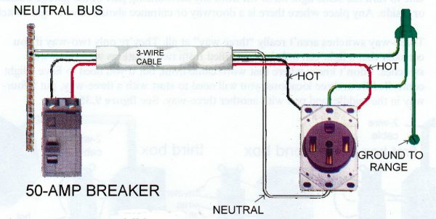
Wiring & Safety Grounding
Only the two voltage-carrying (hot) wires in a four-conductor line cord should be attached to fuses or circuit breakers in a device operated from a 240-VAC single-phase source.

Slide 40
Wiring & Safety Grounding
Use wire rated for the expected current load
Current rating for wire is ampacity
Two most common sizes of house wiring:
#12 AWG for 20 amp circuits (usually outlets)
#14 AWG for 15 amp circuits (usually lighting)
# Twelve = Twenty amps
# Fourteen = Fifteen amps

Slide 41
Protective Components
Fuses and circuit breakers prevent equipment damage and fire by removing voltage when there is a current overload
Use fuses rated for voltage in use and with the recommended current rating
Place a fuse or circuit breaker in the AC hot wire, never in the neutral wire
Opening the neutral wire does not remove voltage from the equipment

Slide 42
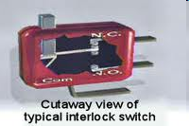
Shock Prevention
Safety interlocks are switches that prevent dangerous voltages or intense RF from being present when a cabinet or enclosure is opened
Interlocks physically disconnect high voltage (HV) power supplies or RF power when activated
Never bypass an interlock during testing unless specifically instructed to do so and then only in the way directed by the instructions

Slide 43
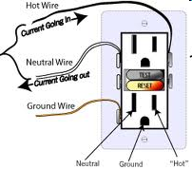
Shock Prevention
A Ground fault circuit interrupter (GFCI) will trip if an imbalance is sensed in the currents carried by the hot and neutral conductors
GFCI breakers can be sensitive to just a few mA of imbalance between hot and neutral, well below the threshold for injury
Use GFCI breakers where moisture is present or direct earth contact with electrically-powered equipment is possible

Slide 44
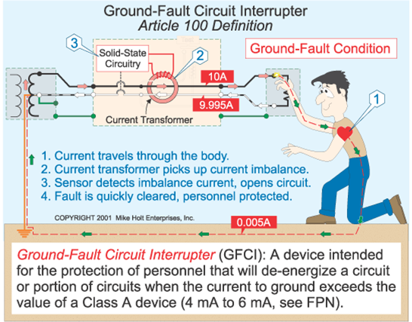
Shock Prevention
Current flowing from one or more of the hot wires directly to ground will cause a Ground Fault Circuit Interrupter (GFCI) to disconnect the 120 or 240 Volt AC line power to a device

Slide 45
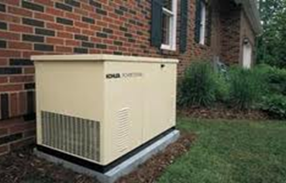
Generator Safety
A generator should never be operated in an enclosed space or basement
Install generators outdoors, in a well-ventilated area away from living areas
Exhaust fumes can be drawn into air intakes or windows or build up in poorly ventilated areas
Install CO detector alarms in living and working areas
Turn the generator off while refueling
Store fuel well away from the generator
A fire extinguisher should be kept near the generator and separated from the fuel

Slide 46
Generator Safety
Danger of carbon monoxide poisoning is a primary reason for not placing a gasoline-fueled generator inside an occupied area
During portable operation, use a ground rod installed at and connected to the generator
When connecting the generator output directly to your home’s wiring system, you must first disconnect your incoming utility power feed by installing a transfer switch
Back-feeding – connecting a generator to the grid through your circuit breaker box. Back-feeding is a serious hazard to electrical workers

Slide 47
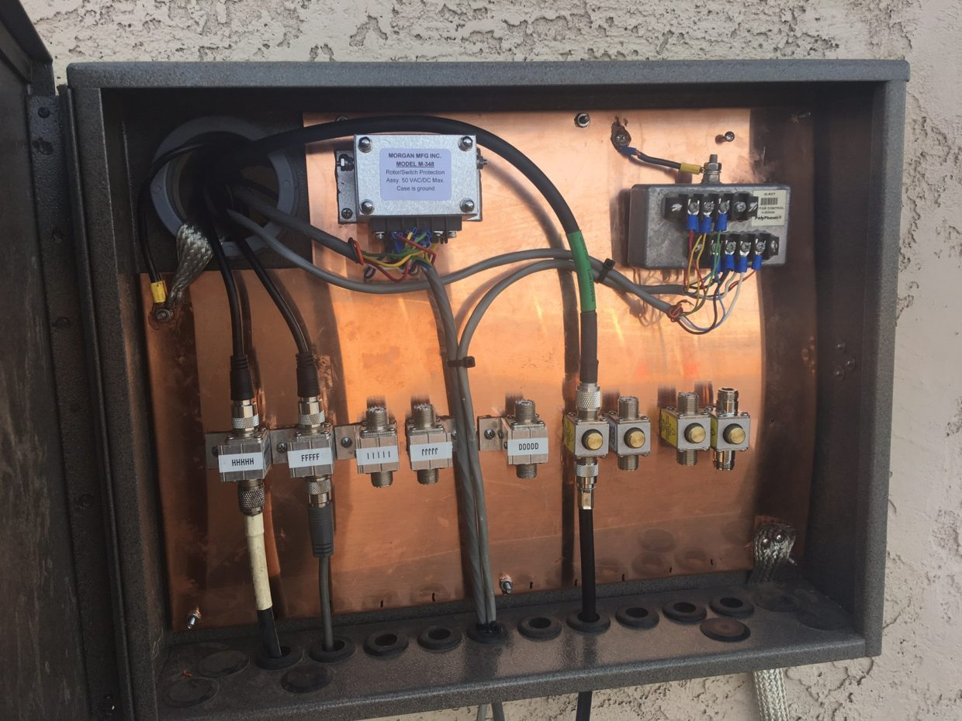
Lightning Protection
Lightning protection provides fire prevention for your home and reduces or prevents electrical damage to your equipment
Use an outside entry panel where signal & control cables enter the house
Panel should be grounded nearby with a heavy, short, ground strap
Panel ground must be bonded to the ac service entry ground with a heavy conductor
Lightning arrestors should be installed at the entry panel
(where feed and control lines enter)
The best protection is to disconnect all cables outside the house and unplug equipment power cords inside the house before a storm

Slide 48
Lightning Protection
Make grounding wires/straps as short and straight as possible
All towers, masts and antenna mounts should be grounded
Lightning grounds must be bonded to all other safety grounds and earth connections, including the electric service ground
Use mechanical clamps, brazing, or welding to be sure the ground connection is mechanically solid. Soldered joints should not be used because a soldered joint will likely be destroyed by the heat of a lightning strike
BTW: Lead from lead-tin solder can contaminate food if hands are not washed carefully after handling

Slide 49
Take Quiz 2

Slide 50
G0B10 - Which of the following is a danger from lead-tin solder?
A. Lead can contaminate food if hands are not washed carefully after handling the solder
B. High voltages can cause lead-tin solder to disintegrate suddenly
C. Tin in the solder can "cold flow," causing shorts in the circuit
D. RF energy can convert the lead into a poisonous gas

Slide 51
G0B10 - Which of the following is a danger from lead-tin solder?
A. Lead can contaminate food if hands are not washed carefully after handling the solder
B. High voltages can cause lead-tin solder to disintegrate suddenly
C. Tin in the solder can "cold flow," causing shorts in the circuit
D. RF energy can convert the lead into a poisonous gas

Slide 52
G0B01 - Which wire or wires in a four-conductor 240 VAC circuit should be attached to fuses or circuit breakers?
A. Only the hot wires
B. Only the neutral wire
C. Only the ground wire
D. All wires

Slide 53
G0B01 - Which wire or wires in a four-conductor 240 VAC circuit should be attached to fuses or circuit breakers?
A. Only the hot wires
B. Only the neutral wire
C. Only the ground wire
D. All wires

Slide 54
G0B02 - According to the National Electrical Code, what is the minimum wire size that may be used safely for wiring with a 20-ampere circuit breaker?
A. AWG number 20
B. AWG number 16
C. AWG number 12
D. AWG number 8

Slide 55
G0B02 - According to the National Electrical Code, what is the minimum wire size that may be used safely for wiring with a 20-ampere circuit breaker?
A. AWG number 20
B. AWG number 16
C. AWG number 12
D. AWG number 8

Slide 56
G0B03 - Which size of fuse or circuit breaker would be appropriate to use with a circuit that uses AWG number 14 wiring?
A. 30 amperes
B. 25 amperes
C. 20 amperes
D. 15 amperes

Slide 57
G0B03 - Which size of fuse or circuit breaker would be appropriate to use with a circuit that uses AWG number 14 wiring?
A. 30 amperes
B. 25 amperes
C. 20 amperes
D. 15 amperes

Slide 58
G0B05 - Which of the following conditions will cause a ground fault circuit interrupter (GFCI) to disconnect AC power?
A. Current flowing from one or more of the hot wires to the neutral wire
B. Current flowing from one or more of the hot wires directly to ground
C. Overvoltage on the hot wires
D. All these choices are correct

Slide 59
G0B05 - Which of the following conditions will cause a ground fault circuit interrupter (GFCI) to disconnect AC power?
A. Current flowing from one or more of the hot wires to the neutral wire
B. Current flowing from one or more of the hot wires directly to ground
C. Overvoltage on the hot wires
D. All these choices are correct

Slide 60
G0B06 - Which of the following is covered by the National Electrical Code?
A. Acceptable bandwidth limits
B. Acceptable modulation limits
C. Electrical safety of the station
D. RF exposure limits of the human body

Slide 61
G0B06 - Which of the following is covered by the National Electrical Code?
A. Acceptable bandwidth limits
B. Acceptable modulation limits
C. Electrical safety of the station
D. RF exposure limits of the human body

Slide 62
G0B12 - What is the purpose of a power supply interlock?
A. To prevent unauthorized changes to the circuit that would void the manufacturer's warranty
B. To shut down the unit if it becomes too hot
C. To ensure that dangerous voltages are removed if the cabinet is opened
D. To shut off the power supply if too much voltage is produced

Slide 63
G0B12 - What is the purpose of a power supply interlock?
A. To prevent unauthorized changes to the circuit that would void the manufacturer's warranty
B. To shut down the unit if it becomes too hot
C. To ensure that dangerous voltages are removed if the cabinet is opened
D. To shut off the power supply if too much voltage is produced

Slide 64
0B09 - Which of the following is true of an emergency generator installation?
A. The generator should be operated in a well-ventilated area
B. The generator must be insulated from ground
C. Fuel should be stored near the generator for rapid refueling in case of an emergency
D. All these choices are correct

Slide 65
0B09 - Which of the following is true of an emergency generator installation?
A. The generator should be operated in a well-ventilated area
B. The generator must be insulated from ground
C. Fuel should be stored near the generator for rapid refueling in case of an emergency
D. All these choices are correct

Slide 66
G4C07 - Why should soldered joints not be used in lightning protection ground connections?
A. A soldered joint will likely be destroyed by the heat of a lightning strike
B. Solder flux will prevent a low conductivity connection
C. Solder has too high a dielectric constant to provide adequate lightning protection
D. All these choices are correct

Slide 67
G4C07 - Why should soldered joints not be used in lightning protection ground connections?
A. A soldered joint will likely be destroyed by the heat of a lightning strike
B. Solder flux will prevent a low conductivity connection
C. Solder has too high a dielectric constant to provide adequate lightning protection
D. All these choices are correct

Slide 68
G0B04 - Where should the station's lightning protection ground system be located?
A. As close to the station equipment as possible
B. Outside the building
C. Next to the closest power pole
D. Parallel to the water supply line

Slide 69
G0B04 - Where should the station's lightning protection ground system be located?
A. As close to the station equipment as possible
B. Outside the building
C. Next to the closest power pole
D. Parallel to the water supply line

Slide 70
G0B11 - Which of the following is required for lightning protection ground rods?
A. They must be bonded to all buried water and gas lines
B. Bends in ground wires must be made as close as possible to a right angle
C. Lightning grounds must be connected to all ungrounded wiring
D. They must be bonded together with all other grounds

Slide 71
G0B11 - Which of the following is required for lightning protection ground rods?
A. They must be bonded to all buried water and gas lines
B. Bends in ground wires must be made as close as possible to a right angle
C. Lightning grounds must be connected to all ungrounded wiring
D. They must be bonded together with all other grounds

Slide 72
G0B13 - Where should lightning arrestors be located?
A. Where the feed lines enter the building
B. On the antenna, opposite the feed point
C. In series with each ground lead
D. At the closest power pole ground electrode

Slide 73
G0B13 - Where should lightning arrestors be located?
A. Where the feed lines enter the building
B. On the antenna, opposite the feed point
C. In series with each ground lead
D. At the closest power pole ground electrode

Slide 74
General License Course
Chapter 9.2 and 9.3
RF Exposure and
Outdoor Safety

Slide 75
RF Exposure
Exposure to RF at low levels is not hazardous
The following properties are important in estimating whether an RF signal exceeds the Maximum Permissible Exposure (MPE) :
Its duty cycle
Its frequency
Its power density (all three are correct)

Slide 76
Power Density
Power density is the intensity of the RF energy and it is measured in mW/cm² (milliwatts per square centimeter)
Heating from exposure to RF signals is caused by the body tissue absorbing RF energy

Slide 77
Power Density
Power density:
Highest near antennas and in the directions in which antennas have the most gain
Increasing transmitter power increases power density
Increasing distance from an antenna lowers power density

Slide 78
Absorption & Limits
Specific absorption rate (SAR) is the rate at which energy is absorbed from the power to which the body is exposed
Safe levels of SAR, called Maximum Permissible Exposure (MPE), are established by the FCC
SAR varies with frequency, power density, average amount of exposure and duty cycle
Body parts absorb RF best when dimensions are similar to the wavelength of the energy

Slide 79
Controlled & Uncontrolled
People in controlled environments are considered to be aware of their exposure (family members) - They can minimize their exposure so a shorter exposure time is considered (6 minutes)
People in uncontrolled environments are not aware of their exposure (neighbors) - Longer exposure times are evaluated (30 minutes)

Slide 80
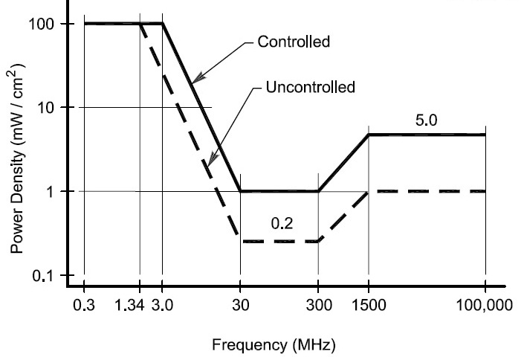
Absorption & Limits

Slide 81
Averaging & Duty Cycle
RF energy is averaged over fixed time intervals because the body responds differently to heating for short and long duration exposures
Time-averaging evaluates the total RF exposure over a specific time interval

Slide 82
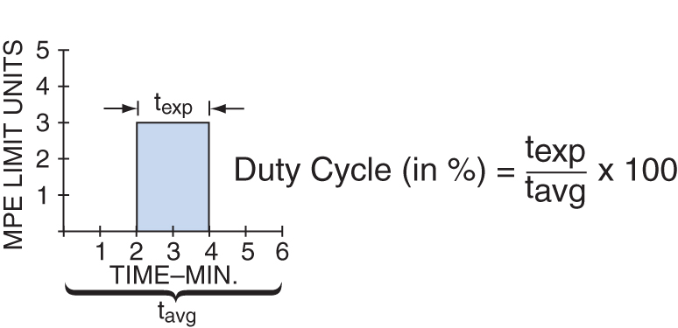
Duty Cycle
Duty cycle is the ratio of the time the transmitter is on to the total time during the exposure
50% duty cycle is half off and half on
Lower transmission duty cycle permits greater short-term exposure levels for a given average exposure (higher power levels)

Slide 83
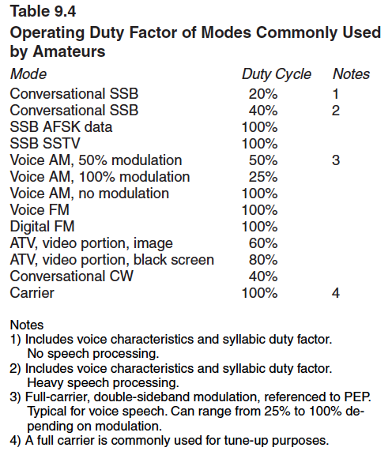
Duty Cycle
Different modes have different emission duty cycles
The likely pattern of use during contacts using that mode

Slide 84
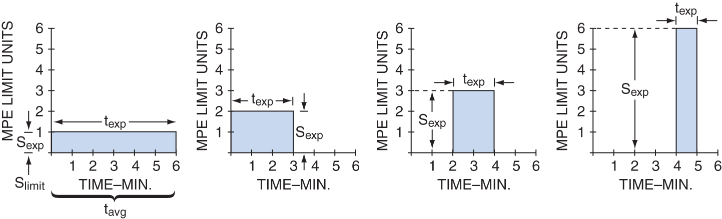
Estimating Exposure & Station Evaluation
"Time averaging" in reference to RF exposure means the total RF exposure averaged over a certain time.
Equivalent exposures...

Slide 85
Antenna System
When estimating exposure, include the following considerations:
Your power output
The amount of gain provided by your antenna
High gain antennas increase a signal’s average power considerably
Losses in the feed line

Slide 86
Estimating Exposure & Station Evaluation
All amateur stations must evaluate their capability to cause RF exposure IF their time-averaged transmission power exceeds ONE milliwatt (next slide...)

Slide 87
Station Evaluation
You can perform the evaluation by accurately measuring the RF field strength with a calibrated field strength meter and calibrated antenna
You can also use computer modeling to determine the exposure levels
You can calculate exposure using FCC OET Bulletin 65 (it's easiest for most hams to use an online calculator listed on the ARRL website)
All three choices are correct!

Slide 88
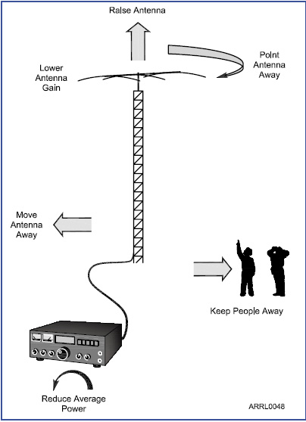
Exposure Safety Limits
If the evaluation shows that your transmissions exceed MPE limits take action to prevent human exposure to excessive RF:
Reduce antenna gain
Reduce average power level
Prevent access to any identified high exposure areas
Take measures to prevent excessive power from being radiated in your neighbors’ direction (including preventing the antenna from being pointed at them when they are present)

Slide 89
Exposure Safety Limits
If you use a stealth or indoor antenna, make sure MPE limits are not exceeded in your home’s living quarters
You are much closer to the antenna than stations with external antennas
Place mobile antennas on the vehicle roof or trunk to minimize exposure to passengers.
Use a dummy load when testing a transmitter
Protect ground-mounted antennas from unauthorized access

Slide 90
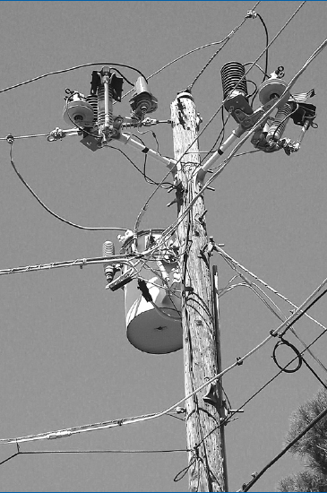
Installing Antennas
Place all antennas and feed lines well clear of power lines!

Slide 91
Installing Antennas
Safety rules dictate that no part of your antenna system should be closer than ten feet from power lines
A good rule of thumb is to separate all parts of the antenna and support from the power lines by at least 150% of total height of tower or mast plus antenna

Slide 92
Installing Antennas
Don’t run feed lines over power lines or service drops from a transformer to the house
If you are shooting lines through or over trees to support a wire antenna, remember that power lines can be hidden in or just beyond trees
Make a thorough visual inspection before starting the installation

Slide 93
Towers Masts & Hardware
Building permits are generally required for towers
Comply with your local building codes
Towers should be grounded with separate 8-foot ground rods for each tower leg, with the ground rods bonded to the tower and each other and to all other safety and RF grounds
Airport – comply with FCC & FAA rules

Slide 94
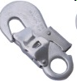
Antenna & Tower Maintenance
Climbers and ground crew must wear the proper applicable safety equipment:
properly rated (weight) safety harness in good condition and still within its service life
always attach the belt safety hook to the belt D-ring with the hook opening away from the tower.
hard hat, gloves, sun block & goggles
boots or work shoes to protect your feet (tower rungs dig in over time)
Have enough crew to do the job safely

Slide 95
Safety Checklist
Run through a safety checklist before starting:
Inspect all tower guying and support hardware
Crank-up towers must be fully nested and blocked to prevent movement
Check that all belts and lanyards are within their allowable service life and that they are rated for the weight of the climber
Inspect all hoist ropes and load-bearing hardware such as pulleys
Lock out (secure) and tag out all electrical equipment supplying power to the tower
Turn off transmitters and disconnect feed lines

Slide 96
Take Quiz 3

Slide 97
G0A01 - What is one way that RF energy can affect human body tissue?
A. It heats body tissue
B. It causes radiation poisoning
C. It causes the blood count to reach a dangerously low level
D. It cools body tissue

Slide 98
G0A01 - What is one way that RF energy can affect human body tissue?
A. It heats body tissue
B. It causes radiation poisoning
C. It causes the blood count to reach a dangerously low level
D. It cools body tissue

Slide 99
G0A02 - Which of the following is used to determine RF exposure from a transmitted signal?
A. Its duty cycle
B. Its frequency
C. Its power density
D. All these choices are correct

Slide 100
G0A02 - Which of the following is used to determine RF exposure from a transmitted signal?
A. Its duty cycle
B. Its frequency
C. Its power density
D. All these choices are correct

Slide 101
G0A03 - How can you determine that your station complies with FCC RF exposure regulations?
A. By calculation based on FCC OET Bulletin 65
B. By calculation based on computer modeling
C. By measurement of field strength using calibrated equipment
D. All these choices are correct

Slide 102
G0A03 - How can you determine that your station complies with FCC RF exposure regulations?
A. By calculation based on FCC OET Bulletin 65
B. By calculation based on computer modeling
C. By measurement of field strength using calibrated equipment
D. All these choices are correct

Slide 103
G0A04 - What does "time averaging" mean when evaluating RF radiation exposure?
A. The average amount of power developed by the transmitter over a specific 24-hour period
B. The average time it takes RF radiation to have any long-term effect on the body
C. The total time of the exposure
D. The total RF exposure averaged over a certain period

Slide 104
G0A04 - What does "time averaging" mean when evaluating RF radiation exposure?
A. The average amount of power developed by the transmitter over a specific 24-hour period
B. The average time it takes RF radiation to have any long-term effect on the body
C. The total time of the exposure
D. The total RF exposure averaged over a certain period

Slide 105
G0A05 - What must you do if an evaluation of your station shows that the RF energy radiated by your station exceeds permissible limits for possible human absorption?
A. Take action to prevent human exposure to the excessive RF fields
B. File an Environmental Impact Statement (EIS-97) with the FCC
C. Secure written permission from your neighbors to operate above the controlled MPE limits
D. All these choices are correct

Slide 106
G0A05 - What must you do if an evaluation of your station shows that the RF energy radiated by your station exceeds permissible limits for possible human absorption?
A. Take action to prevent human exposure to the excessive RF fields
B. File an Environmental Impact Statement (EIS-97) with the FCC
C. Secure written permission from your neighbors to operate above the controlled MPE limits
D. All these choices are correct

Slide 107
G0A06 - What must you do if your station fails to meet the FCC RF exposure exemption criteria?
A. Perform an RF Exposure Evaluation in accordance with FCC OET Bulletin 65
B. Contact the FCC for permission to transmit
C. Perform an RF exposure evaluation in accordance with World Meteorological Organization guidelines
D. Use an FCC-approved band-pass filter

Slide 108
G0A06 - What must you do if your station fails to meet the FCC RF exposure exemption criteria?
A. Perform an RF Exposure Evaluation in accordance with FCC OET Bulletin 65
B. Contact the FCC for permission to transmit
C. Perform an RF exposure evaluation in accordance with World Meteorological Organization guidelines
D. Use an FCC-approved band-pass filter

Slide 109
G0A07 - What is the effect of modulation duty cycle on RF exposure?
A. A lower duty cycle permits greater power levels to be transmitted
B. A higher duty cycle permits greater power levels to be transmitted
C. Low duty cycle transmitters are exempt from RF exposure evaluation requirements
D. High duty cycle transmitters are exempt from RF exposure requirements

Slide 110
G0A07 - What is the effect of modulation duty cycle on RF exposure?
A. A lower duty cycle permits greater power levels to be transmitted
B. A higher duty cycle permits greater power levels to be transmitted
C. Low duty cycle transmitters are exempt from RF exposure evaluation requirements
D. High duty cycle transmitters are exempt from RF exposure requirements

Slide 111
G0A08 - Which of the following steps must an amateur operator take to ensure compliance with RF safety regulations?
A. Post a copy of FCC Part 97.13 in the station
B. Notify neighbors within a 100-foot radius of the antenna of the existence of the station and power levels
C. Perform a routine RF exposure evaluation and prevent access to any identified high exposure areas
D. All these choices are correct

Slide 112
G0A08 - Which of the following steps must an amateur operator take to ensure compliance with RF safety regulations?
A. Post a copy of FCC Part 97.13 in the station
B. Notify neighbors within a 100-foot radius of the antenna of the existence of the station and power levels
C. Perform a routine RF exposure evaluation and prevent access to any identified high exposure areas
D. All these choices are correct

Slide 113
G0A09 - What type of instrument can be used to accurately measure an RF field strength?
A. A receiver with digital signal processing (DSP) noise reduction
B. A calibrated field strength meter with a calibrated antenna
C. An SWR meter with a peak-reading function
D. An oscilloscope with a high-stability crystal marker generator

Slide 114
G0A09 - What type of instrument can be used to accurately measure an RF field strength?
A. A receiver with digital signal processing (DSP) noise reduction
B. A calibrated field strength meter with a calibrated antenna
C. An SWR meter with a peak-reading function
D. An oscilloscope with a high-stability crystal marker generator

Slide 115
G0A10 - What should be done if evaluation shows that a neighbor might experience more than the allowable limit of RF exposure from the main lobe of a directional antenna?
A. Change to a non-polarized antenna with higher gain
B. Use an antenna with a higher front-to-back ratio
C. Take precautions to ensure that the antenna cannot be pointed in their direction when they are present
D. All these choices are correct

Slide 116
G0A10 - What should be done if evaluation shows that a neighbor might experience more than the allowable limit of RF exposure from the main lobe of a directional antenna?
A. Change to a non-polarized antenna with higher gain
B. Use an antenna with a higher front-to-back ratio
C. Take precautions to ensure that the antenna cannot be pointed in their direction when they are present
D. All these choices are correct

Slide 117
G0A11 - What precaution should be taken if you install an indoor transmitting antenna?
A. Locate the antenna close to your operating position to minimize feed-line radiation
B. Position the antenna along the edge of a wall to reduce parasitic radiation
C. Make sure that MPE limits are not exceeded in occupied areas
D. Make sure the antenna is properly shielded

Slide 118
G0A11 - What precaution should be taken if you install an indoor transmitting antenna?
A. Locate the antenna close to your operating position to minimize feed-line radiation
B. Position the antenna along the edge of a wall to reduce parasitic radiation
C. Make sure that MPE limits are not exceeded in occupied areas
D. Make sure the antenna is properly shielded

Slide 119
G0A12 - What stations are subject to the FCC rules on RF exposure?
A. All commercial stations; amateur radio stations are exempt
B. Only stations with antennas lower than one wavelength above the ground
C. Only stations transmitting more than 500 watts PEP
D. All stations with a time-averaged transmission of more than one milliwatt

Slide 120
G0A12 - What stations are subject to the FCC rules on RF exposure?
A. All commercial stations; amateur radio stations are exempt
B. Only stations with antennas lower than one wavelength above the ground
C. Only stations transmitting more than 500 watts PEP
D. All stations with a time-averaged transmission of more than one milliwatt

Slide 121
G0B07 - Which of these choices should be observed when climbing a tower using a safety harness?
A. Always hold on to the tower with one hand
B. Confirm that the harness is rated for the weight of the climber and that it is within its allowable service life
C. Ensure that all heavy tools are securely fastened to the harness
D. All these choices are correct

Slide 122
G0B07 - Which of these choices should be observed when climbing a tower using a safety harness?
A. Always hold on to the tower with one hand
B. Confirm that the harness is rated for the weight of the climber and that it is within its allowable service life
C. Ensure that all heavy tools are securely fastened to the harness
D. All these choices are correct

Slide 123
G0B08 - What should be done before climbing a tower that supports electrically powered devices?
A. Notify the electric company that a person will be working on the tower
B. Make sure all circuits that supply power to the tower are locked out and tagged
C. Unground the base of the tower
D. All these choices are correct

Slide 124
G0B08 - What should be done before climbing a tower that supports electrically powered devices?
A. Notify the electric company that a person will be working on the tower
B. Make sure all circuits that supply power to the tower are locked out and tagged
C. Unground the base of the tower
D. All these choices are correct

Slide 125
Next Week
EXAMS!
Take Practice Tests Online!
But, before you go...

